Slide 1

Comparative Analysis of Deep Learning Models for Road Damage Detection and Segmentation
YOLOv8, ResNet, and Enhanced EfficientNet-B4 + U-Net
FINAL YEAR
PROJECT PHASE-I
Submitted by Project Guide
Manikandan G (22619111) Dr. G. Revathy, M. E., Ph. D
Dhinesh kumar S (22619135) Assistant Professor
Department of AI & ML
School of Engineering
VISTAS

Slide 2
ABSTRACT
Automated detection and segmentation of road surface damage are vital for smart-city maintenance and safety. Manual inspections are slow, costly, and prone to human error, motivating the use of deep-learning vision systems for scalable road monitoring. This study compares three deep models ResNet-based segmentation, YOLOv8 detection, and a proposed Enhanced EfficientNet-B4 + U-Net on a unified pothole segmentation dataset of 780 annotated images under varied lighting and surface conditions. The proposed model, featuring channel-attention skip connections and deep supervision, achieved 94% accuracy, Dice = 0.74, and IoU = 0.62, outperforming ResNet (0.67, 0.54) and YOLOv8 (0.47). Ablation results confirm improved boundary precision and faster convergence. Overall, the model provides a strong balance of accuracy and efficiency for automated road-quality mapping and maintenance planning, with future work focusing on larger datasets and real-time edge deployment.
Index Terms— Deep Learning, Road Damage Detection, EfficientNet, U-Net, YOLOv8, Semantic Segmentation, Pothole Detection, Computer Vision

Slide 3
Introduction :
Road surface damage like potholes, cracks, and depressions poses a serious threat to vehicles and driver safety.
Manual road inspection is slow, labor-intensive, and inconsistent, leading to delayed maintenance.
Automated detection using deep learning and computer vision can provide fast, reliable, and consistent results.
The goal is to use AI to make road inspection smart, accurate, and scalable for modern infrastructure management.

Slide 4
Problem Statement :
Roads in many countries degrade due to heavy traffic, rainfall, and aging.
Human-based inspection systems often fail to detect damage on time.
Current AI models have limitations:
  Detection models (YOLO) are fast but not precise.
  Segmentation models (U-Net, ResNet) are accurate but computationally heavy.
A single framework combining accuracy and real-time efficiency is still needed.

Slide 5
Research Objectives :
Compare the performance of three deep-learning models – ResNet (baseline), YOLOv8 (detector), and Enhanced EfficientNet-B4 + U-Net (proposed).
Develop an improved segmentation model that provides high accuracy, precise boundaries, and fast convergence.
Evaluate and analyze results using Pixel Accuracy, Dice Score, and IoU metrics.
Demonstrate how the proposed model can be applied to automated road-quality monitoring systems.

Slide 6
Literature Review :
Several studies have explored YOLO, ResNet, and CNNs for pothole and crack detection.
Most focused only on object detection (bounding boxes) rather than segmentation.
Others used sensor-fusion or accelerometer-based systems but lacked image-level precision.
This research bridges the gap by providing a comprehensive comparison on a single, unified dataset, ensuring fair evaluation.

Slide 7
Comparison Benchmark:
TABLE I: Benchmark comparison with recent literature (2020–2025). Our model achieves the best overall segmentation metrics.

Slide 8
Dataset Description :
The dataset used is Farzad Nekouei’s Pothole Image Segmentation Dataset (Kaggle).
A curated subset of 780 annotated images was prepared:
  720 for training
  60 for validation
Images vary in:
  Lighting (day/night, dry/wet conditions)
  Damage size (small cracks to large potholes)
  Texture and road types
Each image has a binary segmentation mask for ground truth labeling.

Slide 9
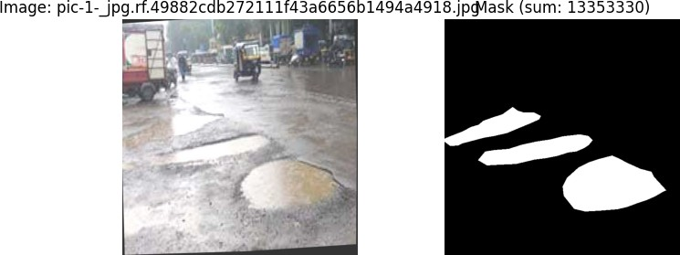
Dataset Representation:
Representative input and corresponding ground-truth mask extracted from the unified dataset.
Left: original image;
Right: binary mask (white = pothole).

Slide 10
Preprocessing and Augmentation :
All images were resized to 512 × 512 pixels for uniformity.
Normalized using ImageNet mean and standard deviation for pre-trained model compatibility.
Data augmentations applied for better generalization:
  Random flips and rotations
  Brightness/contrast adjustments
  Gaussian blur and color jitter
  Random scaling between 0.8 – 1.2
These techniques improved robustness under diverse real-world scenarios.

Slide 11
Model 1 – ResNet (Segmentation Baseline)
Uses ResNet-34 encoder pre-trained on ImageNet.
Attached to a simple decoder with upsampling and convolution layers.
Benefits: lightweight and easy to train.
Drawbacks: lacks attention mechanisms and deep supervision, leading to weaker boundary precision.
Serves as a baseline for comparison.

Slide 12
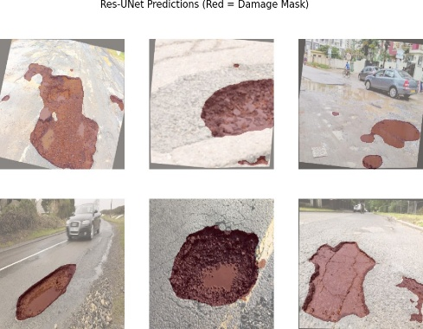
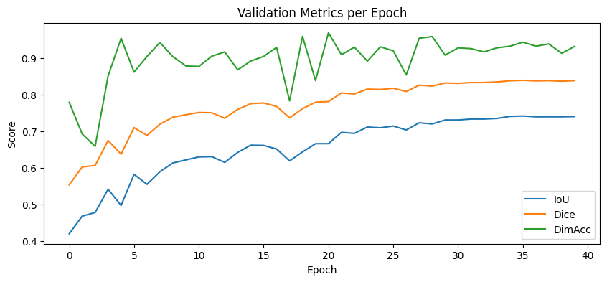
Model 1 – ResNet

Slide 13
Model 2 – YOLOv8 (Detection Baseline)
YOLOv8 is a state-of-the-art object detector capable of real-time performance.
Detects potholes as bounding boxes instead of pixel masks.
Strengths:
  Extremely fast and suitable for mobile or vehicle-mounted devices.
  Performs well in quick localization tasks.
Limitations:
  Not suitable for accurate segmentation or volume estimation.
  Only identifies the damaged region roughly.

Slide 14
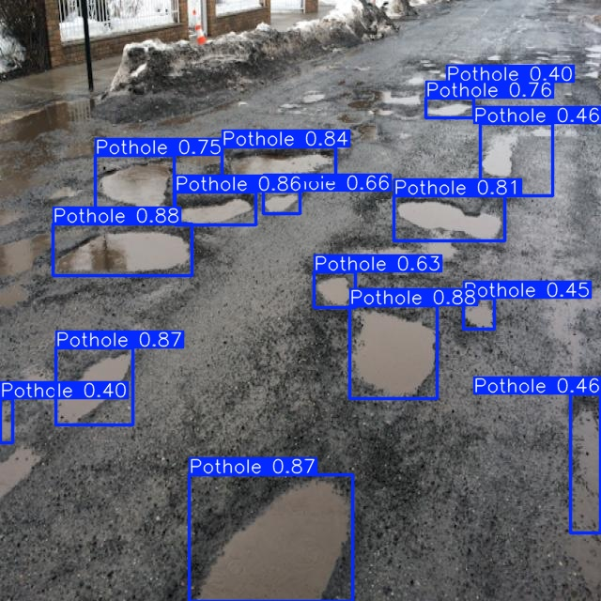
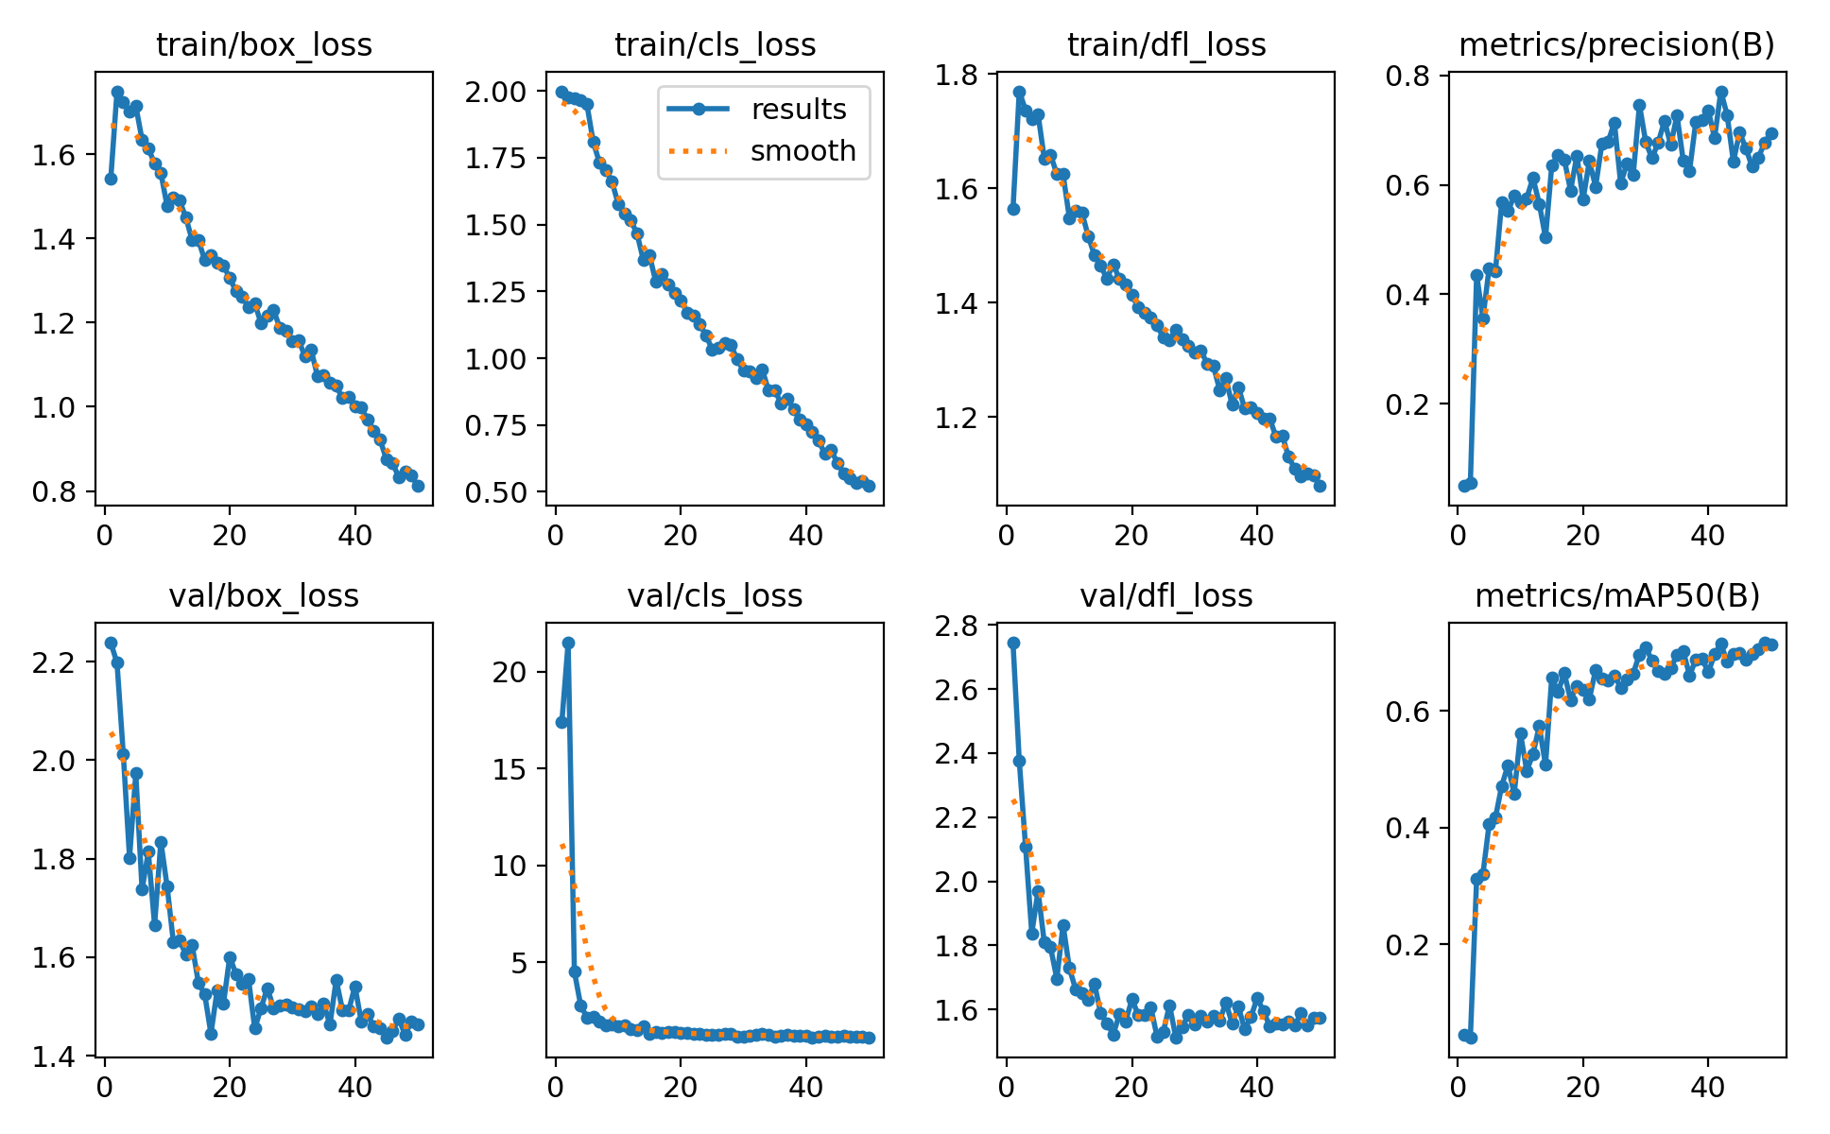
Model 2 – YOLOv8 (Detection Baseline)

Slide 15
Model 3 – Enhanced EfficientNet-B4 + U-Net (Proposed)
Combines the EfficientNet-B4 encoder with a U-Net decoder for detailed segmentation.
Key enhancements:
  Channel-attention skip connections – focus on important features and reduce noise.
  Deep supervision – auxiliary outputs improve training stability and boundary sharpness.
Provides high feature richness and precise segmentation.
Outperforms other models in Dice and IoU metrics.

Slide 16
Workflow and Architecture
Input Image (512×512)
Dataset Acquisition & Curation
Conv Stem
Preprocessing & Augmentation
MBConv Block 1
UpSample ×2 Conv Block
Model Training (ResNet / YOLOv8 / EffNet-U-Net)
MBConv Block 2
UpSample ×2 Conv Block
MBConv Block 3
UpSample ×2 Conv Block
Validation & Metrics
MBConv Block 4
UpSample ×2 Conv Block
Inference & Deployment
Encoder Output
1-Channel Sigmoid Probability Mask

Slide 17
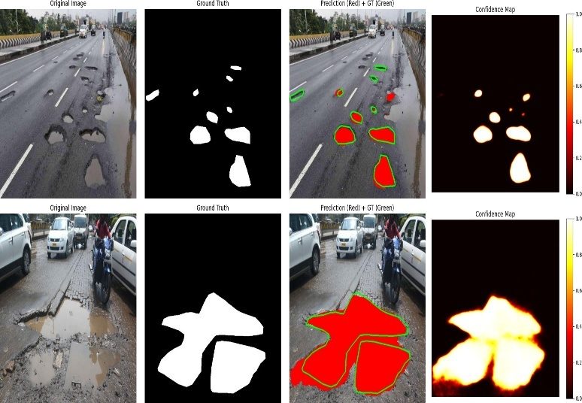
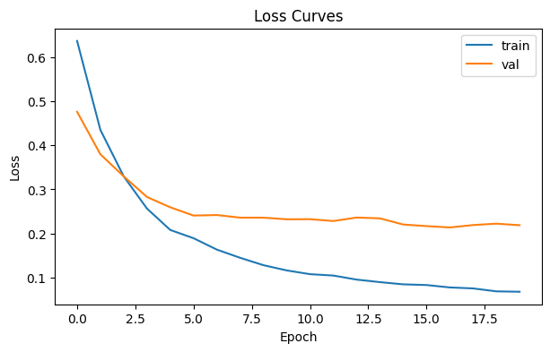
Model 3 – Enhanced EfficientNet-B4 + U-Net

Slide 18
Training Configuration :
Optimizer: AdamW
Learning Rate: Cosine-decay schedule with 5-epoch warm-up
Loss Function: Combined BCE (Binary Cross-Entropy) + Dice Loss with equal weights
Batch Size: 8
Precision: Mixed precision training (AMP) for memory efficiency
Early stopping used to avoid overfitting.
All models trained under identical preprocessing and augmentation protocols for fairness

Slide 19
Evaluation Metrics
Accuracy: Measures overall correct predictions.
Dice Coefficient: Measures overlap between predicted and actual damage areas.
IoU (Intersection over Union): Measures the common area shared between predicted and true regions.
TABLE I: Model comparison on unified pothole segmentation dataset (validation).

Slide 20
TABLE III: Ablation study (validation).
Each enhancement improved both Dice and IoU scores.
Attention skips reduced noise and deep supervision boosted learning speed.

Slide 21
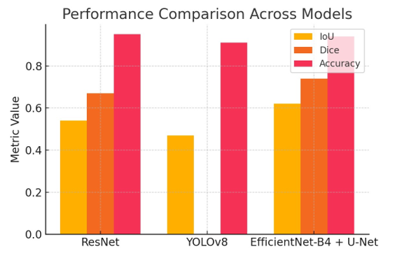
Qualitative Results :
Visual results show clear differences:
  ResNet: Coarse boundaries and incomplete detection.
  YOLOv8: Boxes only, lacks segmentation accuracy.
  Proposed Model: Sharp, smooth pothole masks closely matching ground truth.
Qualitative analysis confirms improved boundary precision and segmentation detail.

Slide 22
Applications :
Smart-city infrastructure: Automate road inspection and maintenance planning.
Fleet-based monitoring: Mounted cameras on vehicles can detect road damage during travel.
Municipal analysis: Create road-quality maps for prioritizing repairs.
Research extension: The model can also detect cracks, patches, and other surface anomalies.

Slide 23
Limitations :
Dataset covers limited locations → affects generalization.
Lighting and water reflection sometimes cause false positives.
Model size (EfficientNet-B4) is heavy for embedded devices.
Requires pruning and quantization for real-time edge deployment.

Slide 24
Future Work :
Expand dataset across more geographic regions and conditions.
Integrate IMU or stereo sensors to estimate pothole depth and volume.
Develop lightweight variants optimized for mobile or vehicle systems.
Explore transformer-based architectures for improved global context.

Slide 25
Conclusion :
A comparative study of ResNet, YOLOv8, and the proposed EfficientNet-U-Net was conducted.
The Enhanced EfficientNet-B4 + U-Net achieved the highest segmentation accuracy with Dice = 0.74 and IoU = 0.62.
The model shows strong potential for automated road damage detection and smart-city applications.
Future work will focus on edge optimization and multimodal fusion for real-time deployment.

Slide 26
REFERENCES
V. Pham et al., “Optimizing YOLO Architectures for Road Damage Detection,” arXiv preprint, 2024.
M. Rahman et al., “Crowdsourced pothole detection with GPS and accelerometers,” J. Transp. Eng., 2022.
D.-L. Bui et al., “Lightweight CNN models for road damage detection,” MDPI Electronics, 2024.
Z. Li et al., “Road crack detection using transformer networks,” Sensors, 2023.
S. Argyroudis et al., “Robust detection of road damage using deep learning ensembles,” Automation in Construction, 2023.
Y. Safyari et al., “A Review of Vision-Based Pothole Detection Methods,” Sensors, 2024.
M. Yurdakul and S. Tasdemir, “An Enhanced YOLOv8 Model for Real-Time Pothole Detection,” arXiv preprint, 2025.
H. Zuo et al., “Intelligent Road Crack Detection and Analysis Based on Improved YOLOv8,” arXiv preprint, 2025.
C. Ruseruka et al., “Pothole Detection and Dimension Estimation Using In-Vehicle Systems,” Transportation Engineering, 2024.
Y. Zanevych et al., “Evaluation of Pothole Detection Under Low-Light Conditions,” Sustainability, 2024.

Slide 27

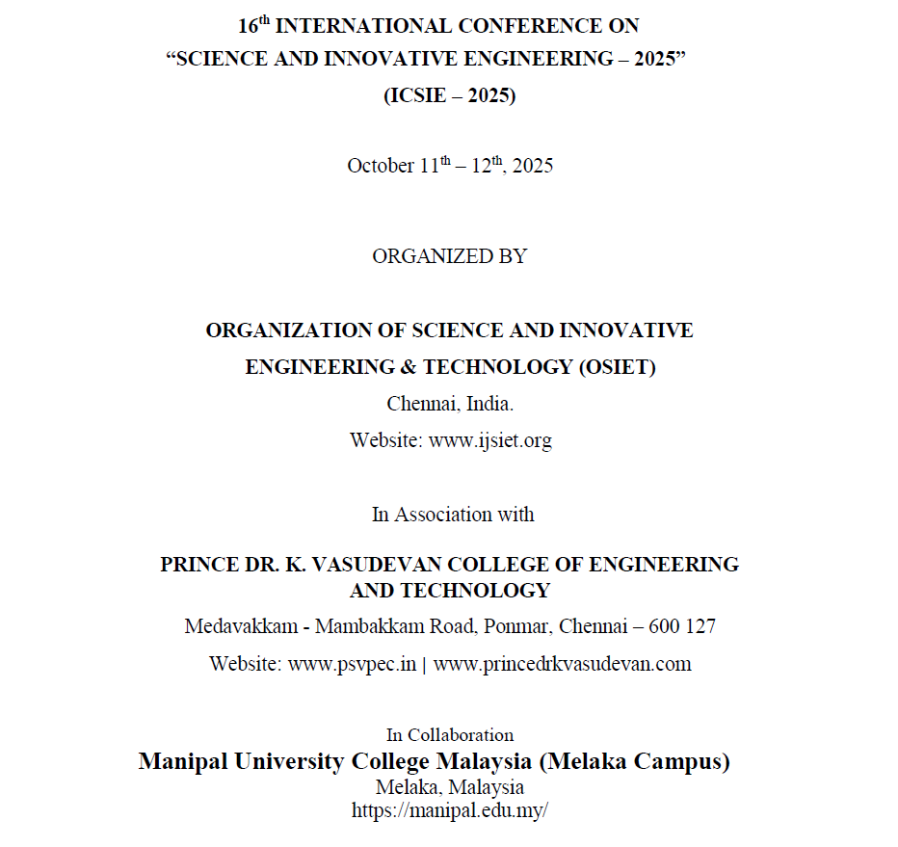
CONFERENCE PROCEDINGS

Slide 28
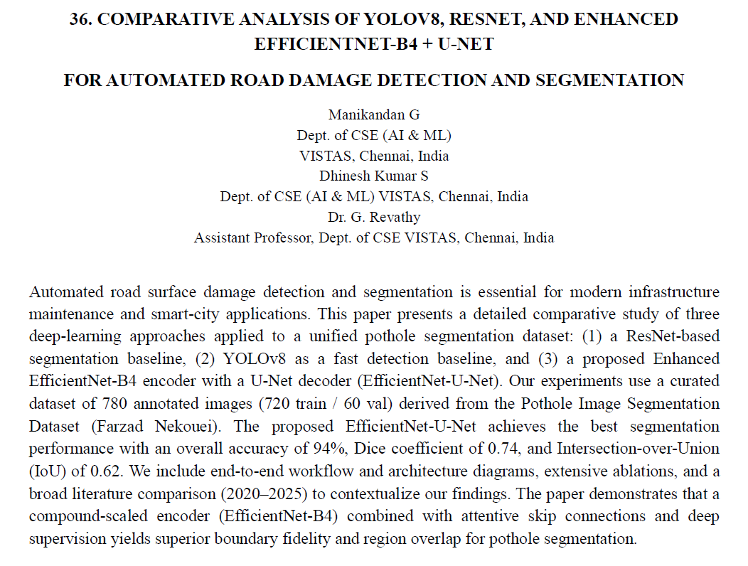
CONFERENCE PROCEDINGS

Slide 29
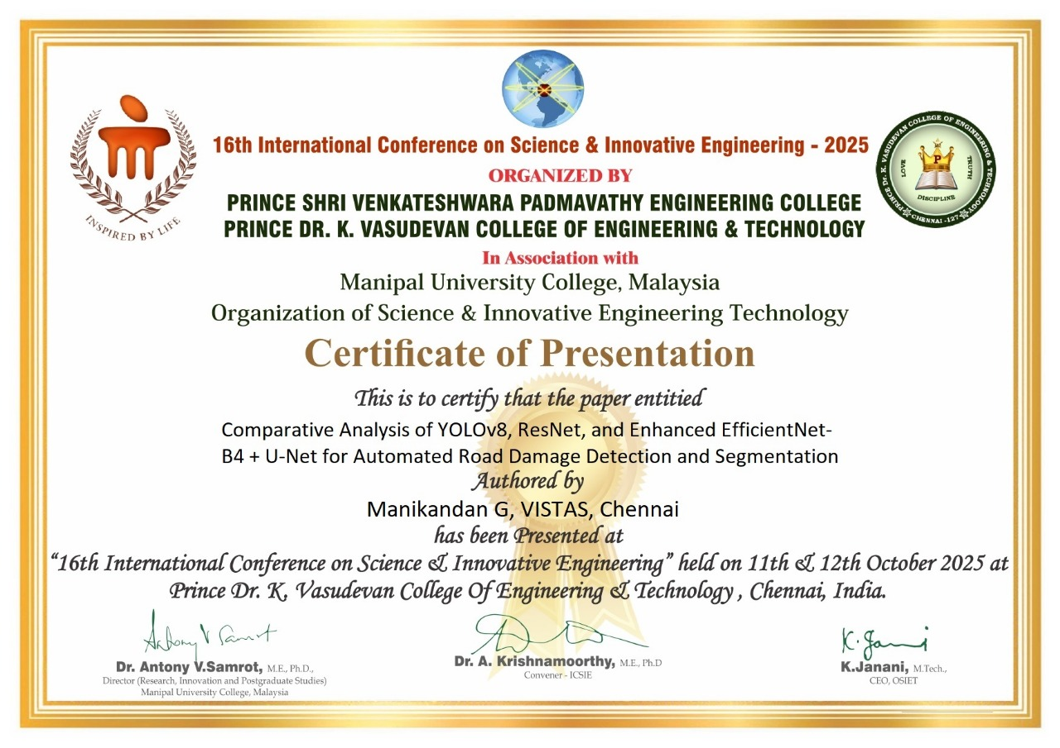

Slide 30


